Slide 1
Controlling branding in SharePoint using add-in model
Vesa Juvonen
Senior Program Manager
Microsoft

Slide 2
Agenda
Introduction
Themes and other branding techniques
Controlling publishing capabilities
Updating existing sites

Slide 3
Developer vision
USERS
DATA
HTML
Notes:
Our Office 365 developer vision focuses on the Users’ experience and their data. As a developer you can bring your applications into their user experience. With over 1.2+ billion users of Office Worldwide, this is a huge opportunity to provide a window into your applications. As well as being able to connect into their data and add intelligence to your applications. There are currently 850 million events created a month and a total of 470Pb+ of data stored in the service that can add value to for our Users’.

Slide 4
Recommendations
Avoid custom master pages
Use Office 365 themes when possible
Consider using Alternate CSS
Themes can be used to control color and fonts
Notes:
Vesa

Slide 5
“You do not brand Outlook or Word, why do you need to do branding on collaboration sites?”
Good question…
Applying branding is absolutely supported and understandable for intranet portals, but what about collaboration sites? It is recommended to consider the cost versus gain

Slide 6
Introduction
Notes:
Controlling branding, recommendations, patterns for add-in model

Slide 7

How to minimize future maintenance?
Use themes rather than master pages
All changes to OOB master pages are provided to your sites automatically without need to modify custom code
Avoid feature framework element usage
Many feature framework elements will create dependency to xml files on the disk , which then cannot be removed easily (think “Content Migration”)
Sandbox solutions will also impact future cost model of the Office365 sites
Notes:
Vesa

Slide 8
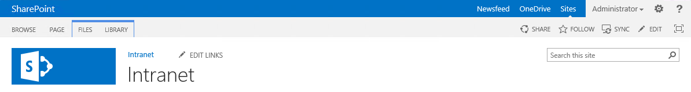
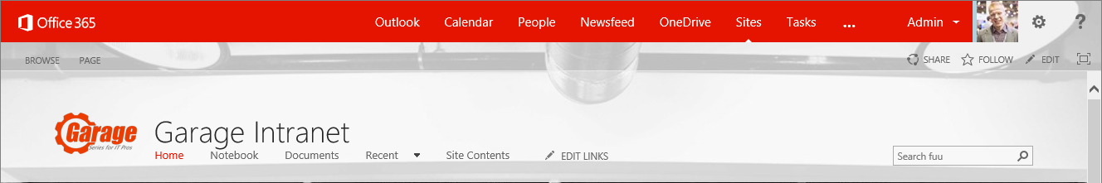
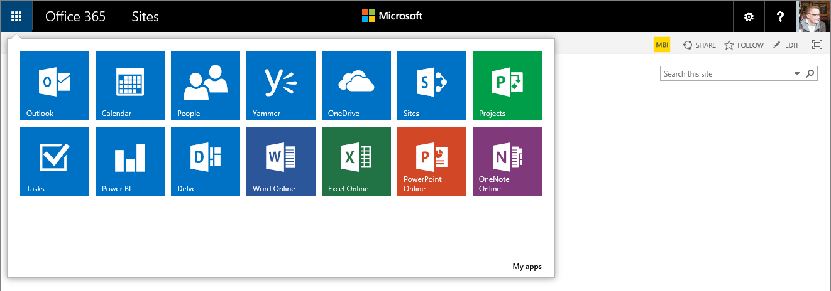
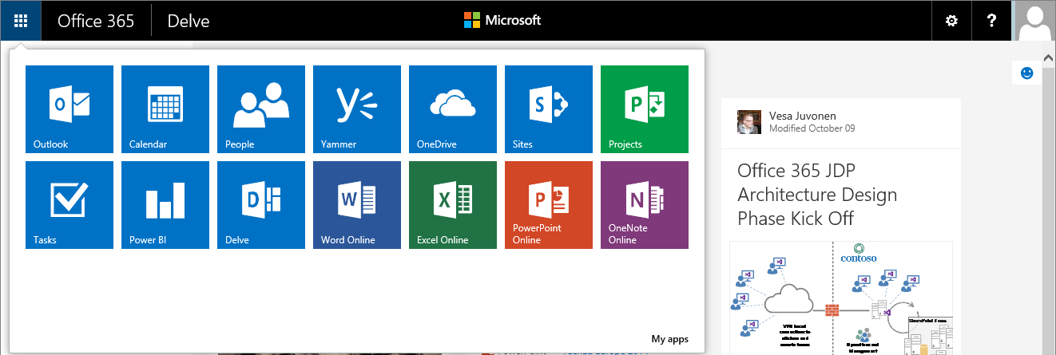
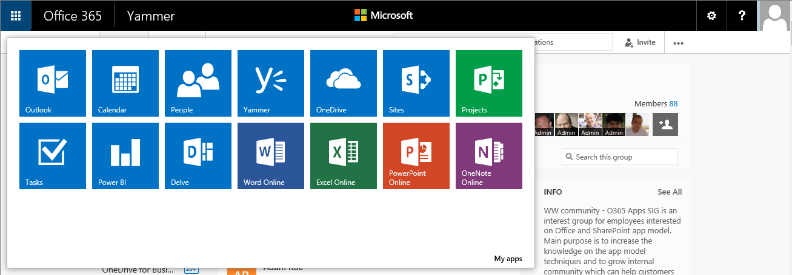
Example: Custom master page and case of an evolving suite bar…
Notes:
Vesa Great Slide to explain the methodology and thinking behind why we want to discourage these EXC

Slide 9
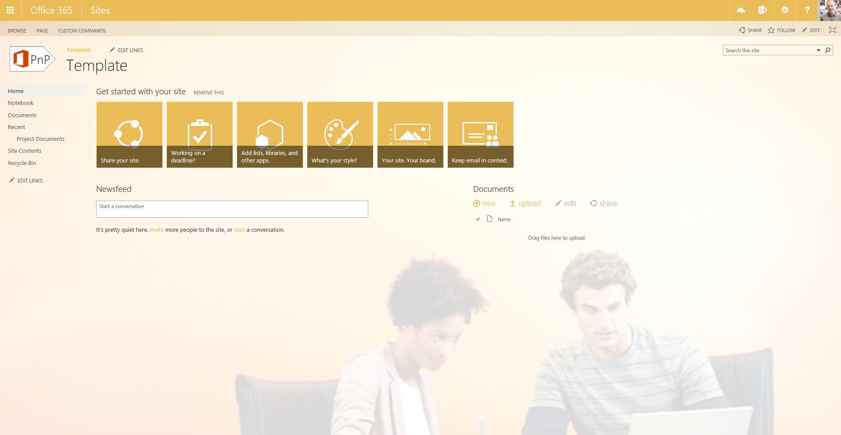
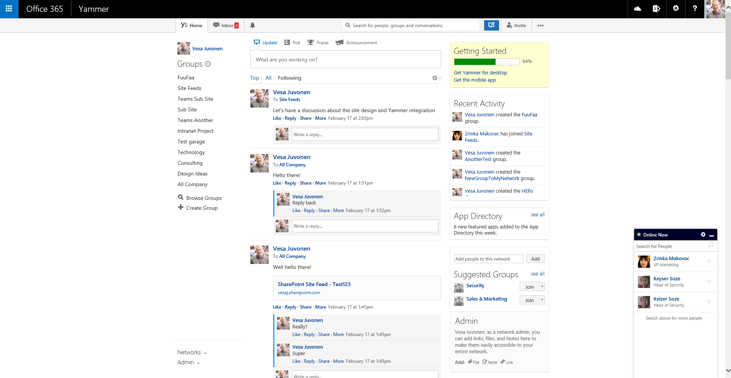
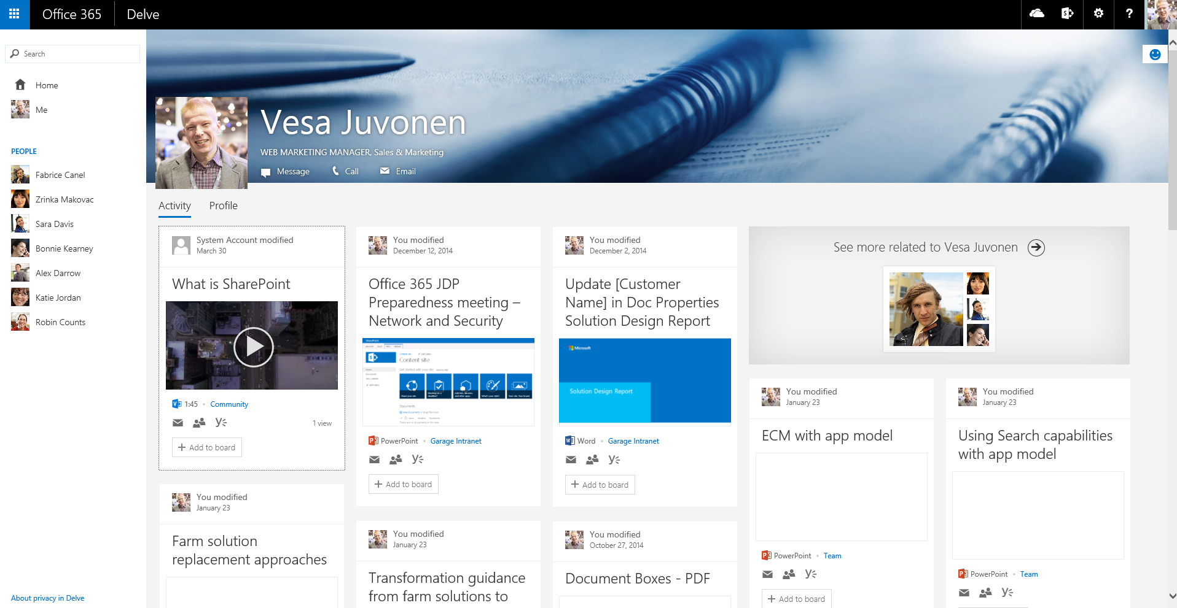
Office 365 services and branding

Slide 10
What is the challenge with custom master page?
New custom master page is created by copying oob master or starting from scratch using oob master as the reference
Significant differences on the outcome unless custom master page been updated during the releases.
contoso.master
contoso.master
contoso.master
master
Version 1.0
master
Version 1.0
master
Version 1.0
<< Copy >>
Custom Master
Oob Master
Seattle.master
Seattle.master
Seattle.master
master
Version 1.0
master
Version 2.0
master
Version 3.0
Time
Service updates for introducing new version of the out of the box master page with some new capabilities or bug fixes.
Notes:
Vesa
Risk is that for sites created from the time WE updated the service until the time YOU updated your Templates, these sites will NOT have all of the features

Slide 11
“But I have always customized my sites with custom master, what has changed?”
Nothing
Actually this similar maintenance challenge exists in on-premises and across the version upgrades as well. Concentrate on what’s truly needed.
Notes:
Vesa

Slide 12
“How should I get my files uploaded to the SharePoint sites? Using sandbox?”
No.
It is recommended to upload files as part of the site provisioning process remotely using so called “remote provisioning” pattern directly using remote APIs.
Notes:
Vesa

Slide 13
“I have an intranet portal and I need to do heavy branding customizations!”
Absolutely fine.
Key point is to understand the impact of the chosen pattern. Custom master pages are completely supported, you might want to use alternative approaches if possible.
Notes:
Vesa

Slide 14
Themes

Slide 15

Themes
What
Provide user branding elements without introducing master page or page layout elements
Why
Continue using out of the box master pages, but introduce customer specific branding elements
How
Use theming engine for introducing color, fonts and background images for sites
Notes:
Steve

Slide 16
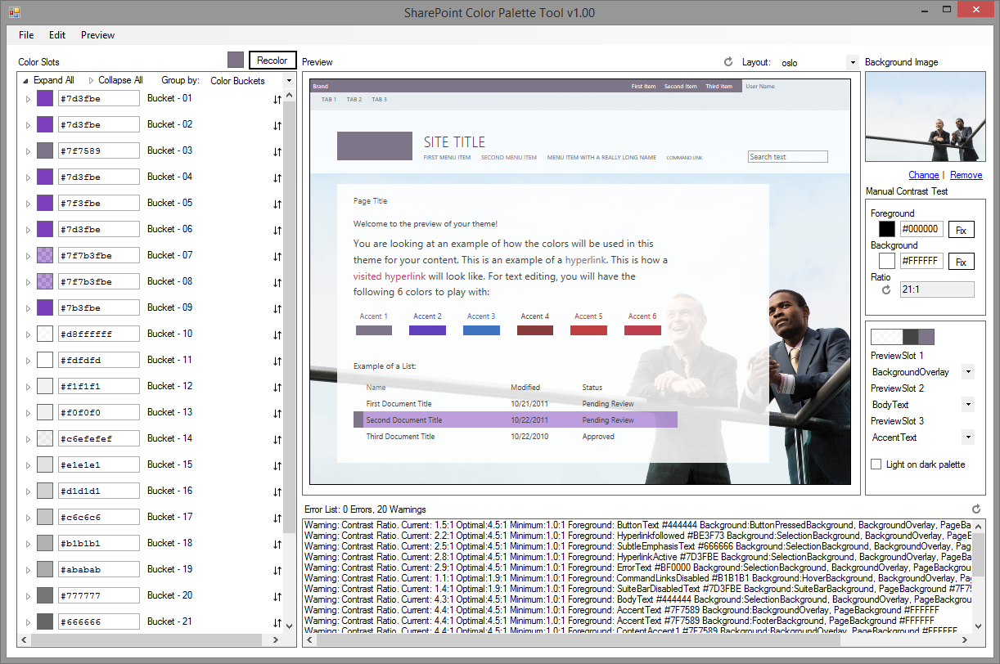
SharePoint Color Palette Tool v1.00
Free downloadable tool to create custom themes based on branding requirements from Microsoft download site
Can be used to create themes in matter of minutes with company colors and images
Notes:
http://www.microsoft.com/en-us/download/confirmation.aspx?id=38182
Steve

Slide 17
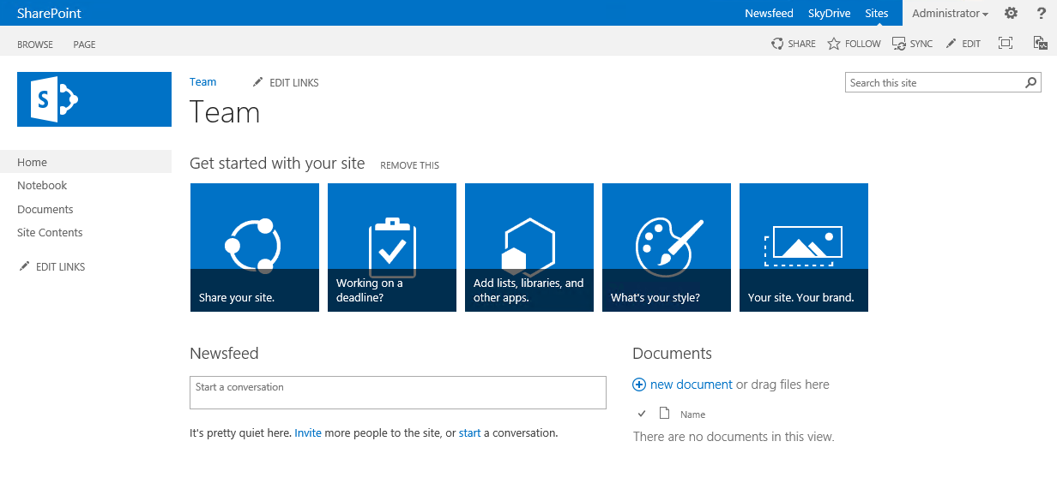
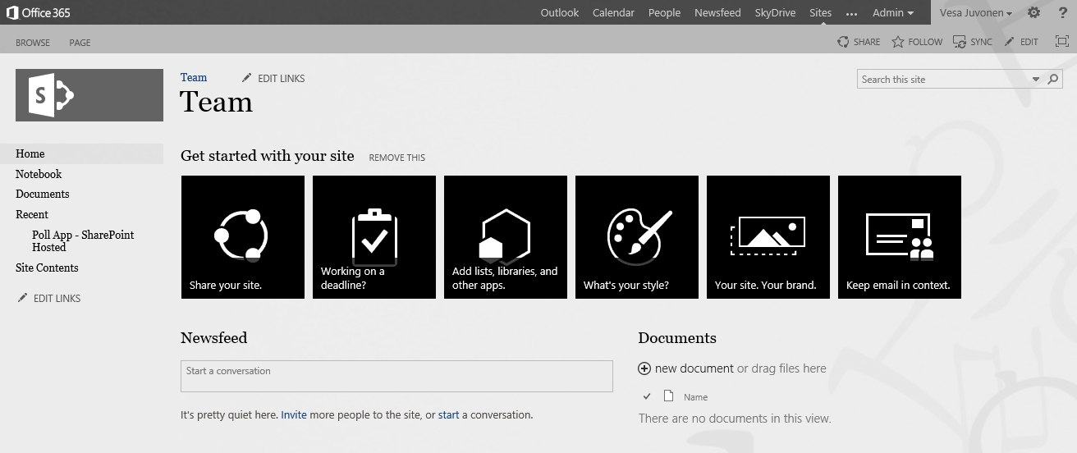
Handling themes from SP add-ins
1
Provider Hosted add-ins
SharePoint Service
CSOM
3
Upload needed files
Set theme to site
(Set master page to site)
Theme elements
2
Color file
Font file
Background image
(Master page)
Notes:
Steve add-in is started from the web by end user or process is started during provisioning
add-in side has the needed theme elements and other assets for sites, which will be published
add-in drives the modification of the host web by applying the needed customizations to host web

Slide 18
Using themes for branding
Demo
https://github.com/OfficeDev/PnP/tree/master/Scenarios/Branding.Themes

Slide 19
Office 365 Themes

Slide 20
Office 365 Themes
What
Control branding settings across different Office 365 services, but not Sites (SharePoint)
Why
Provide branding consistency across all services, like Yammer, Delve or OneDrive for Business
How
You can control company wide default branding settings from the Office 365 administration services
SharePoint sites use Office 365 if site specific theme is not applied
Personal theming option can be disabled by tenant administrator, if needed

Slide 21
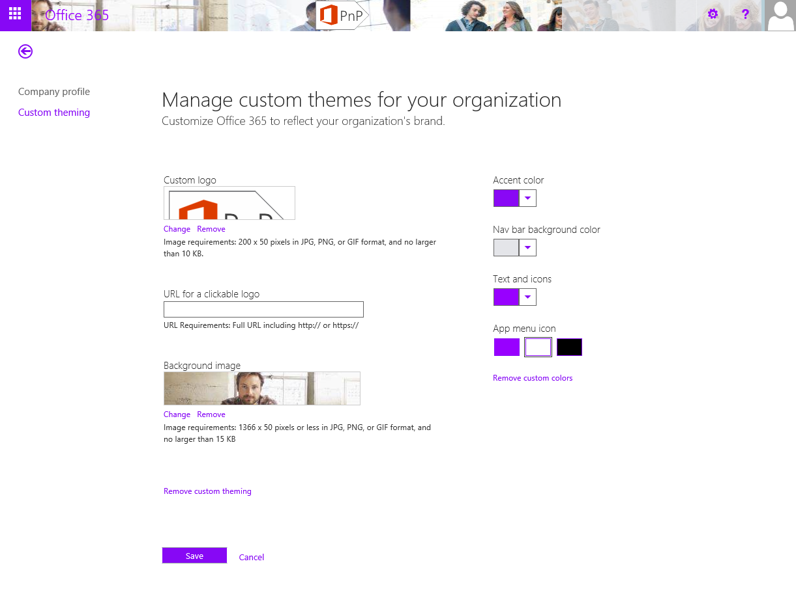
Controlling themes for Office 365
Notes:
vesa

Slide 22
Office 365 themes
Demo

Slide 23
Alternate CSS

Slide 24
Adding alternative styling for host web
What
Provide alternate CSS styling elements to the web by adding custom style elements to the page rendering process
Why
To provide more comprehensive changes on the page layout compared to what themes can do without introducing a custom master page
How
Use the AlternateCSSUrl web object property, which was introduced as new capability in the 2014 April CU for SharePoint 2013
Notes:
Vesa

Slide 25
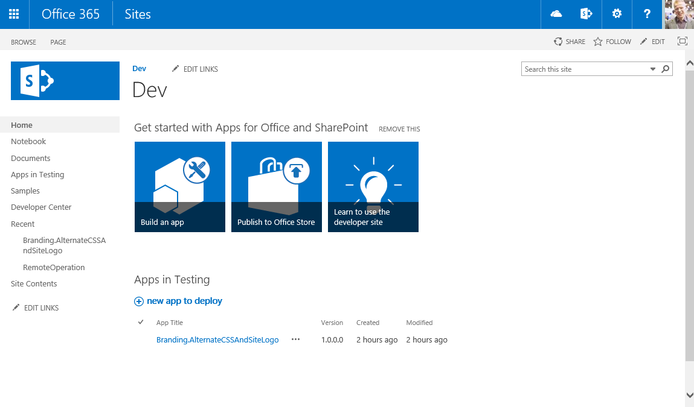
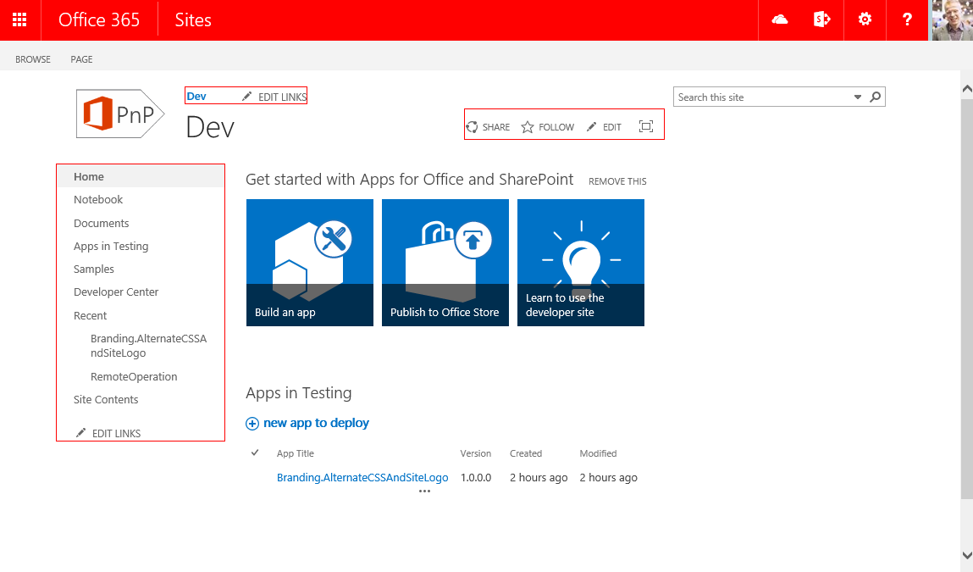
Controlling CSS from add-in
1
Provider Hosted add-ins
SharePoint Service
CSOM/REST
3
Upload CSS
Set alternate CSS for the site
Assets
2
CSS file
Images
Notes:
add-in is started from the web by end user or process is started during provisioning
add-in side has the needed theme elements and other assets for sites, which will be published
add-in drives the modification of the host web by applying the needed customizations to host web

Slide 26
Using custom css and custom logo
Demo
https://github.com/OfficeDev/PnP/tree/master/Samples/Branding.AlternateCSSAndSiteLogo

Slide 27
Branding with publishing sites

Slide 28
Recommendations for master page
IF you should choose that Master Pages are right for you, AND you are ok with the ongoing potential maintenance… THEN
Minimize your changes compared to out of the box master pages
Change only what is needed in the master and combine to themes and possibly alternate CSS option for easier maintenance
Deploy master pages directly using remote API rather than using sandbox solutions
Design packages are also Sandbox solutions
Notes:
Steve

Slide 29
Controlling master page and page layouts from add-in
1
Provider Hosted add-ins
SharePoint Service
CSOM/REST
3
Upload master page
Upload page layouts
Set site master page using CSOM
Set page layouts
Set allowed site templates
Branding assets
2

Slide 30
Branding and publishing sites
Demo
https://github.com/OfficeDev/PnP/tree/master/Scenarios/Provisioning.PublishingFeatures

Slide 31
Summary on branding options

Slide 32


Branding options for SharePoint sites
Office 365 Themes
Theme
Alternate CSS
Custom Master Page
Can be used to centrally control branding cross all services in the Office 365
Limited settings currently
Can be overridden in site level
Only in Office 365, not in on-premises
Can be used to control branding, fonts and background image of the sites
Configuration applied to each site
Can be used to override whatever CSS settings
Control to color, fonts and even layout settings
Configuration applied to each site
Full control on how the site is rendered
Applied to each site, except for publishing sites
Any updates to oob master pages are not automatically reflected on the sites
Options
Support
only
Flexibility
Fair
Average
Good
Unlimited
Cost impact (short and long term)

Slide 33
Updating branding on existing sites

Slide 34
Updating Branding on existing sites
What
Update branding and other settings in the sites after they are created based on new requirements
Why
It’s common that there have to be some adjustment done to the sites, that have been previously created
How
Provision shared static elements like images, CSS files, and JavaScript files to one location and reference them from sites as needed with relative path
Elements which has to be stored in site collection level can be updated by looping through the sites and update them one by one using remote provisioning model without downtime
Notes:
Vesa

Slide 35
“So I would have to loop through all sites and update stuff one by one?”
Yes.
This can take a while with thousands of sites, but there’s no down time for doing this. You can also pinpoint specific sites to be updated first if needed.
Notes:
NOTE: How did you do it before with Farm Solutions ?????
Vesa

Slide 36


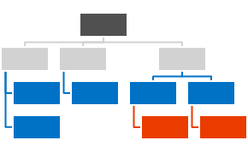
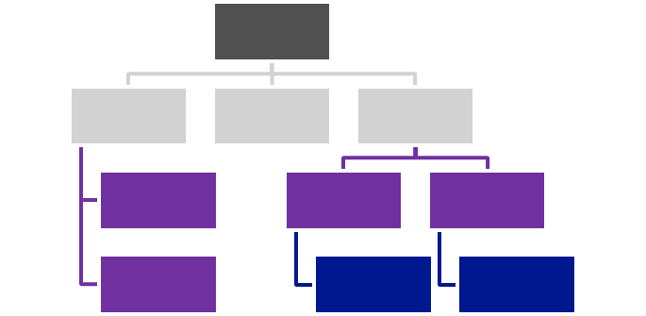



Centralized Asset Deployment
https://Contoso.sharepoint.com /sites/site
https://Contoso.sharepoint.com
<<Reference>>
https://Contoso.sharepoint.com /sites/site2
<<Reference>>
<<Reference>>
<<Reference>>
Provider Hosted add-in
<<Reference>>
https://Contoso.sharepoint.com /sites/site3
<<Reference>>
Notes:
Vesa Static assets like images, JS files, and CSS files are deployed together with the master page and asp files to the root site collection of the a web application or a tenant.
Dynamic files like master pages and other asp pages are deployed to the each site collections.
Static files are referenced from the root site collection using relative links.
Provides one location to change most of the functionalities and there’s no need to deploy all the image, CSS, or JS files to each of the site collection.

Slide 37
Recommendations
Avoid custom master pages
Use Office 365 themes when possible
Consider using Alternate CSS
Themes can be used to control color and fonts
Notes:
Vesa

Slide 38
Questions?

Slide 39

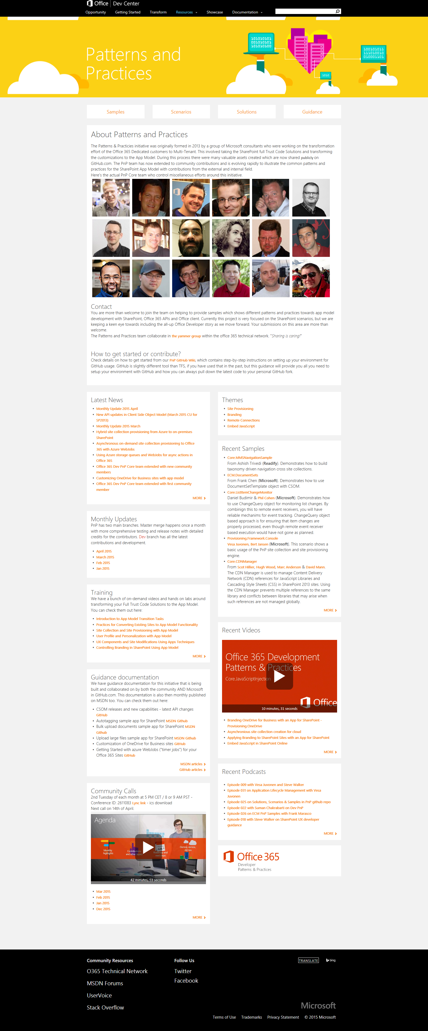
“Sharing is caring”
aka.ms/OfficeDevPnP
aka.ms/OfficeDevPnPYammer
aka.ms/OfficeDevPnPMSDN
aka.ms/OfficeDevPnPVideos
aka.ms/OfficeDevPnPTraining

Slide 40


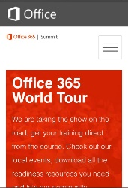
dev.office.com
Sign up
http://dev.office.com/getting-started
Explore
http://apisandbox.msdn.microsoft.com
Get trained http://dev.office.com/training

Slide 41


Feedback
Office 365 Network Share you best practices and join conversations
https://www.yammer.com/itpronetwork
Stackoverflow Ask deep technical questions to a world-wide set of developers
http://stackoverflow.com/questions/tagged/ms-office
UserVoice Provide suggestions of what you want in future versions
http://officespdev.uservoice.com/

Slide 42


© 2015 Microsoft Corporation. All rights reserved. Microsoft, Windows, and other product names are or may be registered trademarks and/or trademarks in the U.S. and/or other countries.
The information herein is for informational purposes only and represents the current view of Microsoft Corporation as of the date of this presentation. Because Microsoft must respond to changing market conditions, it should not be interpreted to be a commitment on the part of Microsoft, and Microsoft cannot guarantee the accuracy of any information provided after the date of this presentation. MICROSOFT MAKES NO WARRANTIES, EXPRESS, IMPLIED OR STATUTORY, AS TO THE INFORMATION IN THIS PRESENTATION.

